Slide 1

Fundamental Concepts in Machine Learning
Professor Bo Liu
James Watt School of Engineering

Slide 2
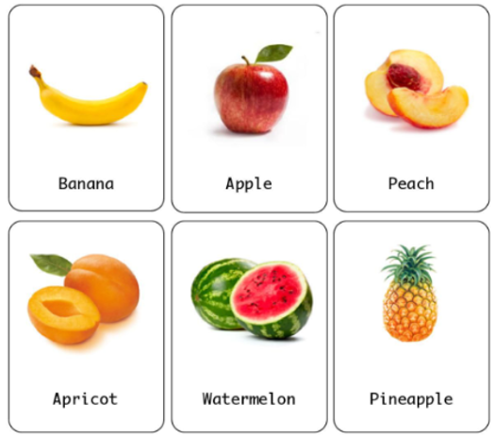
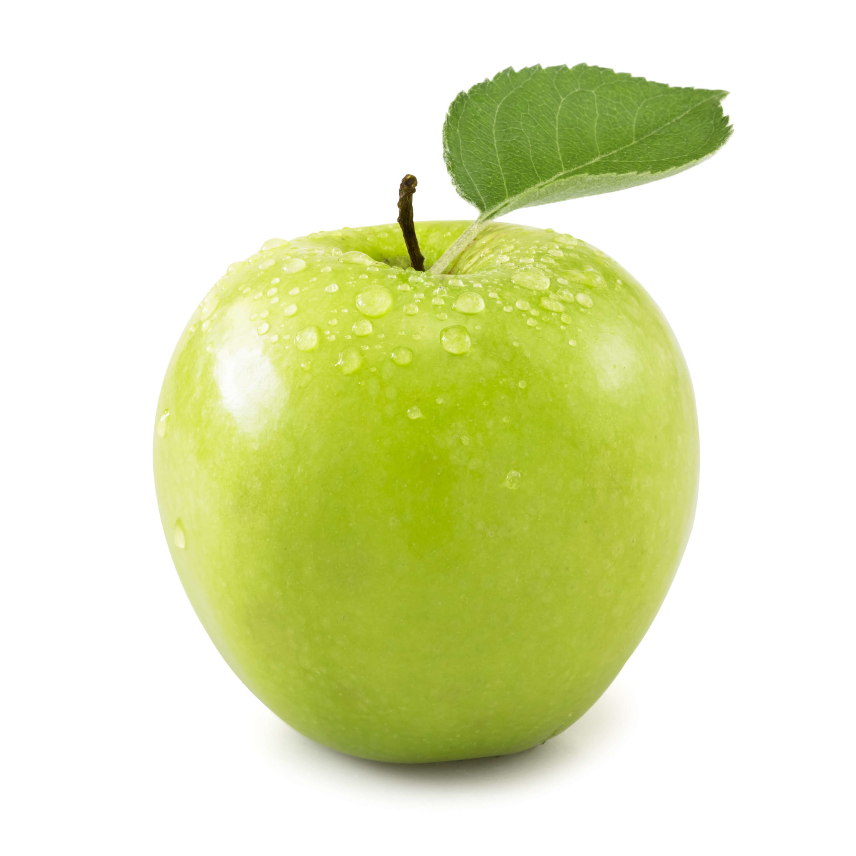
Fundamental concepts in ML: model
  Model: a specific representation learned from data by applying some ML algorithm(s).
Once trained, the model can be used to reason/predict data that it has not seen before.
  To predict a fruit, a model is trained by fruit image dataset.
  After training, the model can be used to recognize/classify an unknown fruit.
image
input
output
apple
or
not apple
Trained model

Slide 3
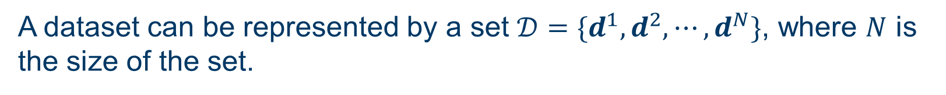
Fundamental concepts in ML: dataset
  Dataset: a collection of data.
  ML is a method that learns from the dataset.
A dataset can be represented by a set $𝒟=\{d^{1},d^{2}, ⋯,d^{N}\}$, where $N$ is the size of the set.
  For example, in order to predict a fruit, we need the dataset of fruit images.

Slide 4
Fundamental concepts in ML: sample
  Sample (instance): A sample is an element in a dataset.
For the dataset $𝒟=\{d^{1},d^{2}, ⋯,d^{N}\}$, $d^{n}$is the n-th sample of the dataset.
  The n-th sample of the fruit dataset may be the image and the name of a fruit.
A sample

Slide 5

Fundamental concepts in ML: training/test dataset
The dataset is often partitioned into training and test sets.
The training dataset is used to train the ML model.
The size of the training data set is bigger than the test data, e.g., (70% of the total data.)
The test dataset is used as a benchmark to evaluate a trained model.
Test dataset is independent of the training dataset.
The size of test dataset is often approximately 20-30% of the total data.
dataset
Training dataset
Test dataset
$≥$60%
~20-30%

Slide 6
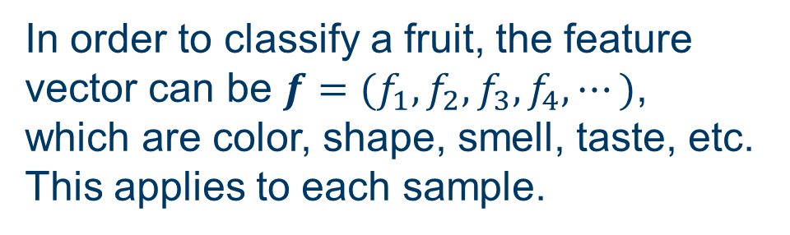
Fundamental concepts in ML: feature
  Feature: A feature is a measurable property of the data.
  A set of features can be conveniently described by a feature vector.
  Feature vectors are fed as input to the model.
  In order to classify a fruit, the feature vector can be $f=(f_{1},f_{2}, f_{3}, f_{4}, ⋯)$, which are color, shape, smell, taste, etc. This applies to each sample.

Slide 7
Fundamental concepts in ML: label
  Label: a label is the value to be predicted by the model.
  For the fruit example, the label would be the name of the fruit like apple, orange, banana, etc.
Label

Slide 8




Thanks!
#UofGWorldChangers
@UofGlasgow

